Slide 1

Get Kinect-ed
How to make the Microsoft Kinect work for you
Chris Gardner
Senior Software Engineer
T & W Operations, Inc.

Slide 2
Road Map
Features
Demos

Slide 3

Appease the Lawyers
This is preliminary software and/or hardware and APIs are preliminary and subject to change.
Page Source: http://icanhas.cheezburger.com/justcapshunz/tag/otter
Image Source: https://i.chzbgr.com/maxW500/7806336256/h86FB62F9/

Slide 4
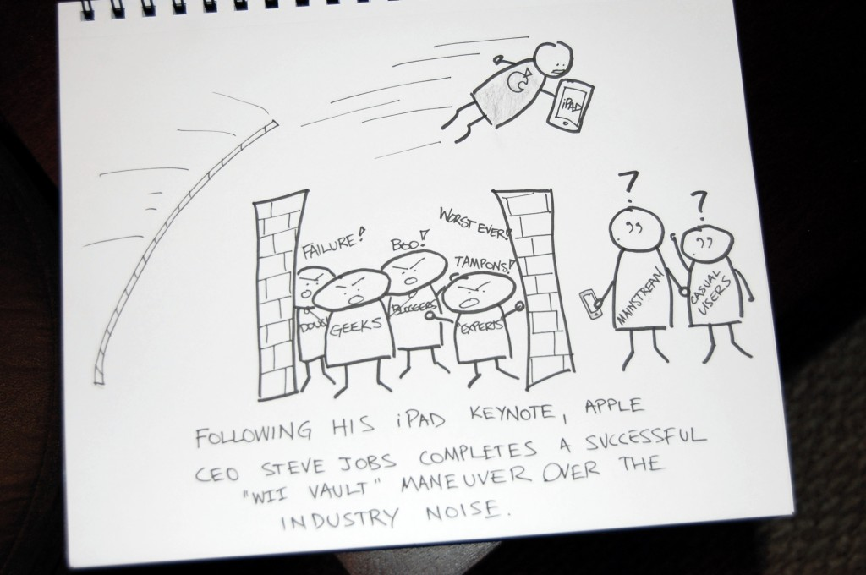
Features
What they want you to think

Slide 5
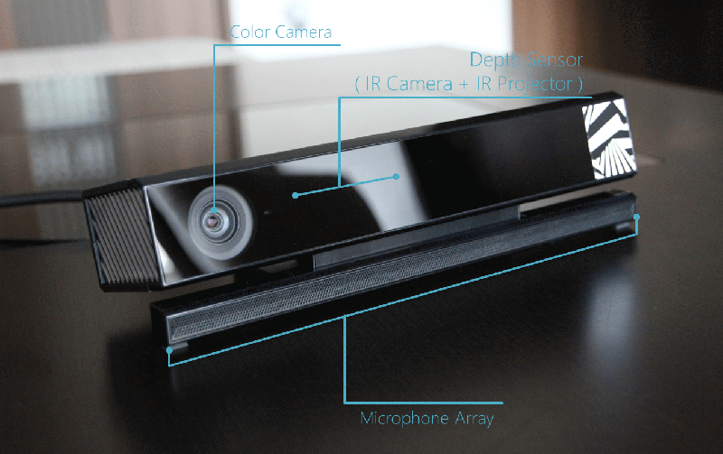
Hardware
Page Source: http://www.eteknix.com/new-windows-v2-kinect-available-for-pre-order-shipping-to-start-on-the-15th-of-july/
Image Source: http://cdn.eteknix.com/wp-content/uploads/2014/06/2014-06-06-image-4.gif

Slide 6
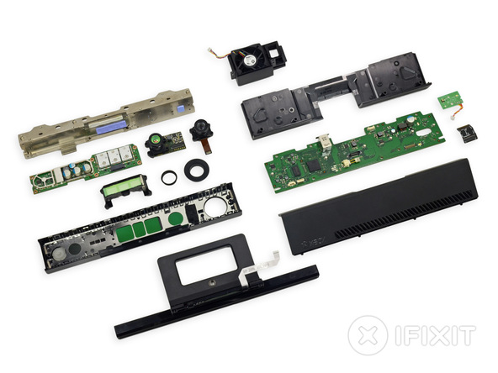
Hardware
http://www.tested.com/tech/gaming/459605-whats-inside-xbox-ones-kinect-sensor/
Page Source: http://www.ifixit.com/Teardown/Xbox+One+Kinect+Teardown/19725
Image Source: http://d3nevzfk7ii3be.cloudfront.net/igi/uiyC2e3PiACHCYuu.medium

Slide 7
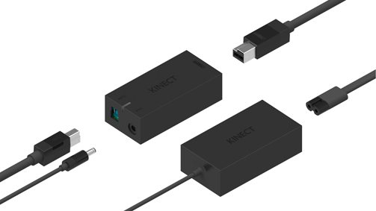
Hardware
Page Source: http://tweakers.net/nieuws/95084/microsoft-toont-hardware-voor-kinect-for-windows-v2.html
Image Source: http://ic.tweakimg.net/ext/i/imagemedium/1395988515.jpeg

Slide 8
Hardware Specs
1080p Color Camera
30fps / 15fps in low light
Depth / Infrared Camera
512x424 at 30fps
Resolution at 0.5 to 4.5 meters
Infrared Emitter
Microphone Array

Slide 9
“Minimum” System Requirements
Operating system
Windows 8(.1)
Windows Embedded Standard 8(.1)
64 bit (x64) processor
I7 3.1-GHz or faster processor
USB 3.0 bus dedicated to the v2 sensor
4 GB RAM
Graphics card that supports DirectX 11

Slide 10
Software Requirements
Visual Studio 2012 or 2013
.NET Framework 4.5
Kinect for Windows v2 SDK
Currently Available as a Public Preview
MS Speech Platform SDK v11
For Speech Recognition
DirectX SDK
For D3D / Native

Slide 11
SDK Features
Framework Support
Native
.NET
WinRT
Unity

Slide 12
SDK Features
Tools
KinectMonitor Service
Background service to automatically start / stop hardware
Kinect Studio
Record streams and playback to the device / app
Hand Pointer Gesture Support
WPF / WinRT to enable built-in gesture support
Gesture Builder

Slide 13
SDK Features
Kinect Fusion
3D Modelling Software
Face Tracking

Slide 14
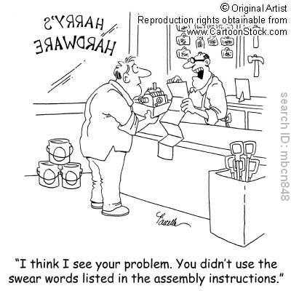
Demo Time
Factory Smoke NOT Included

Slide 15
Questions?
Thank You
Chris Gardner
cgardner@tnwops.com
http://www.tnwops.com
@freestylecoder
http://blog.freestylecoding.com
http://www.extra-life.org/participant/cgardner

